Slide 1

Phishing Attacks
Be aware, be prepared, be safe.
PRESENTED BY
DINESH JEEV
Certified: CEH | CEC | ISO27001 Lead Audit | CISA |

Slide 2

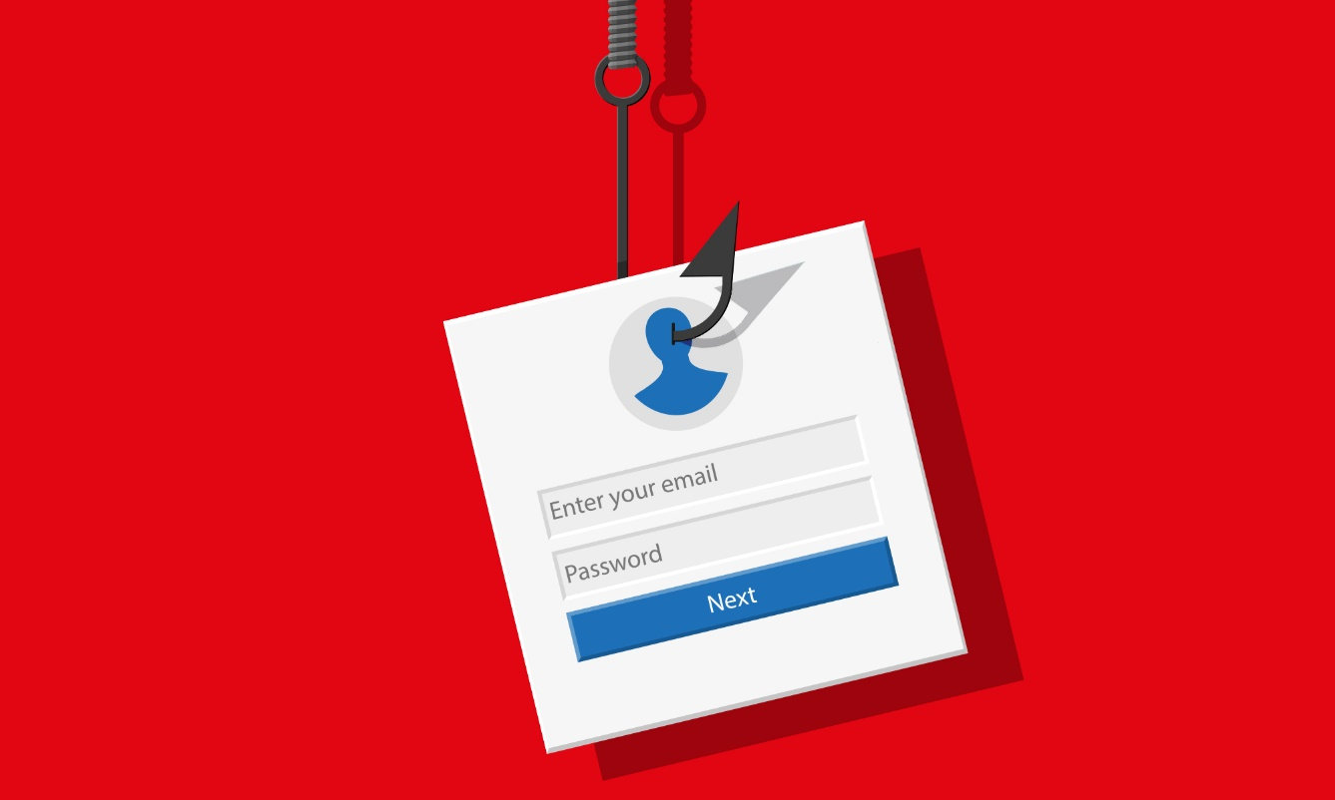
Recap : On Previous Session
Social Engineering
Phishing
Types of Phishing
Effects of Phishing
Protection against Phishing

Slide 3
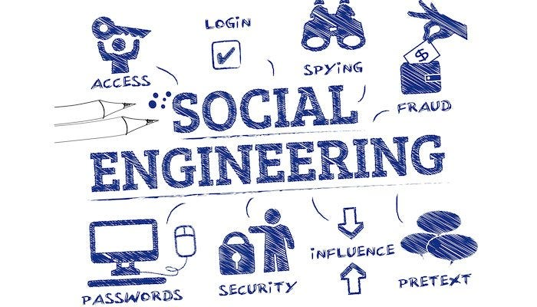
What is Social Engineering?
Social engineering is the art of manipulating, influencing, or deceiving you in order to gain control over your computer system.
Social engineering is the term used for a broad range of malicious activities accomplished through human interactions. It uses psychological manipulation to trick users into making security mistakes or giving away sensitive information.
Attackers who use social engineering don’t need to hack into databases or breakthrough cybersecurity tools. Instead, they convince targets to willingly hand over sensitive information by imitating trustworthy companies or offering fake products
These scammers can target anything from credit card numbers and bank account information to secured files and devices.

Slide 4
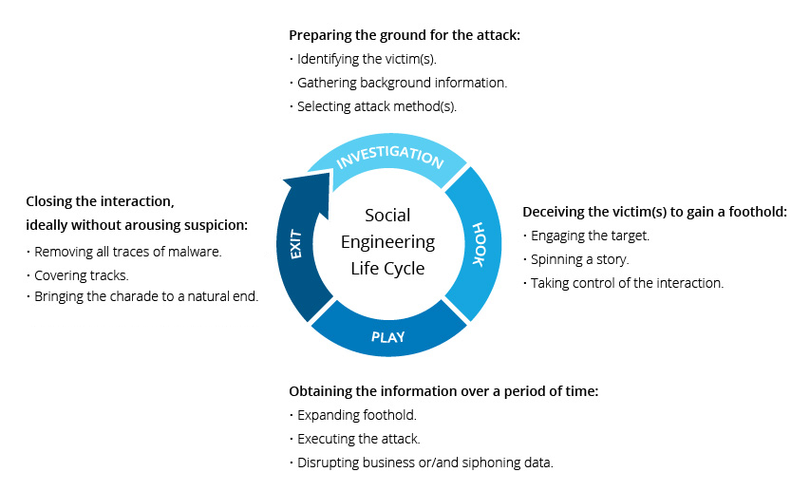
Lifecycle of Social Engineering

Slide 5
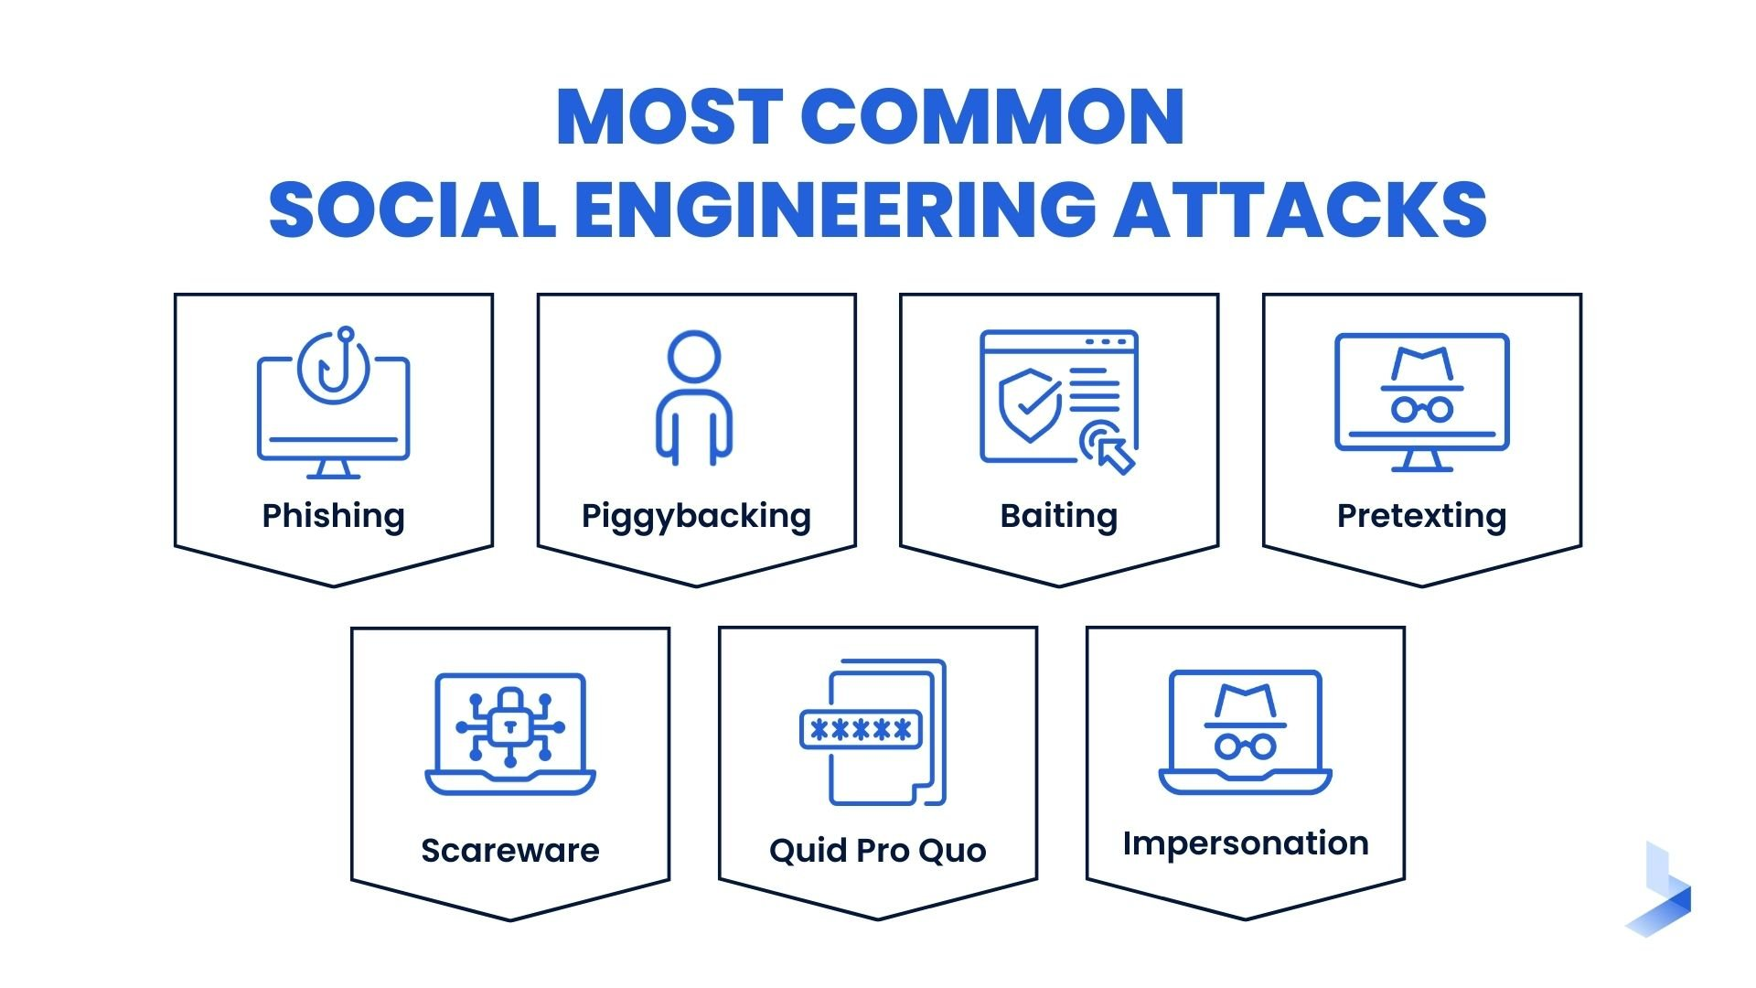

Slide 6
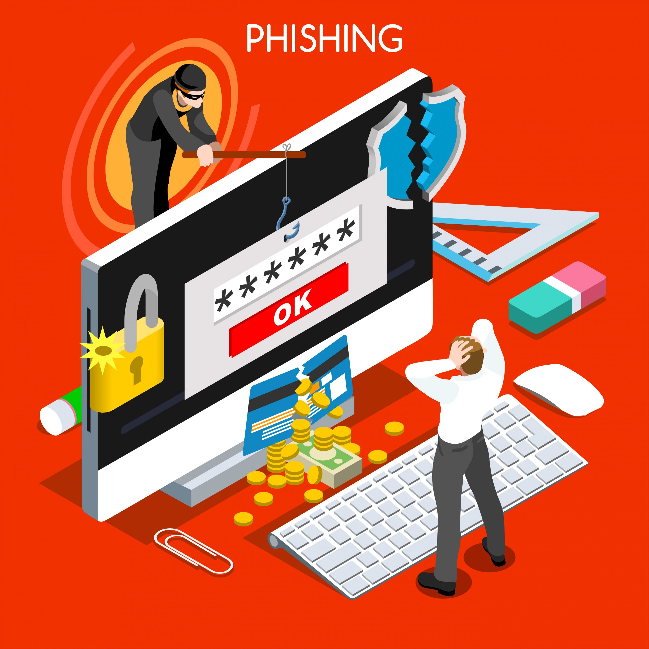

Slide 7
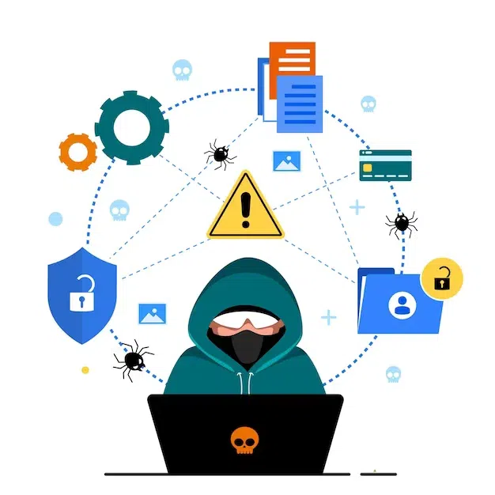
What is Phishing?
Phishing is the most common type of social engineering, which is a general term describing attempts to manipulate or trick computer users.
A phishing attack aims to trick the recipient into falling for the attacker's desired action, such as revealing financial information, system login credentials, or other sensitive information.
Some say the term phishing got influences from the word fishing. Analogous to fishing, phishing is also a technique to “fish” for usernames, passwords, and other sensitive information, from a “sea” of users.
A technique for attempting to acquire sensitive data, such as bank account numbers, through a fraudulent solicitation in email or on a web site, in which the perpetrator masquerades as a legitimate business or reputable person.

Slide 8
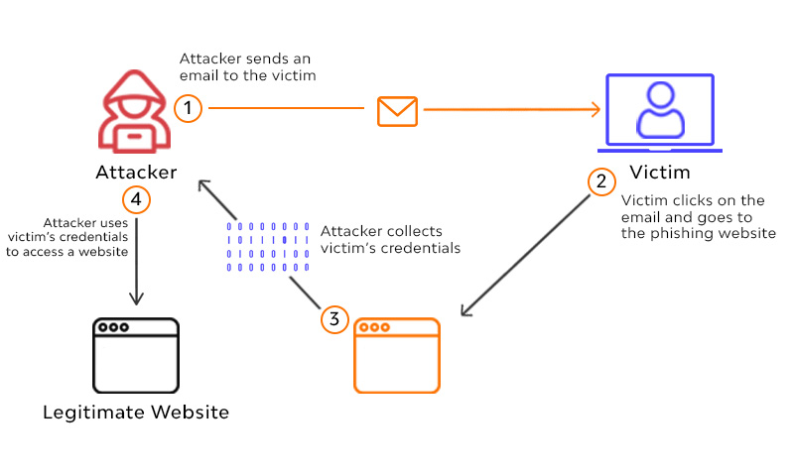

How does Phishing attack works?

Slide 9
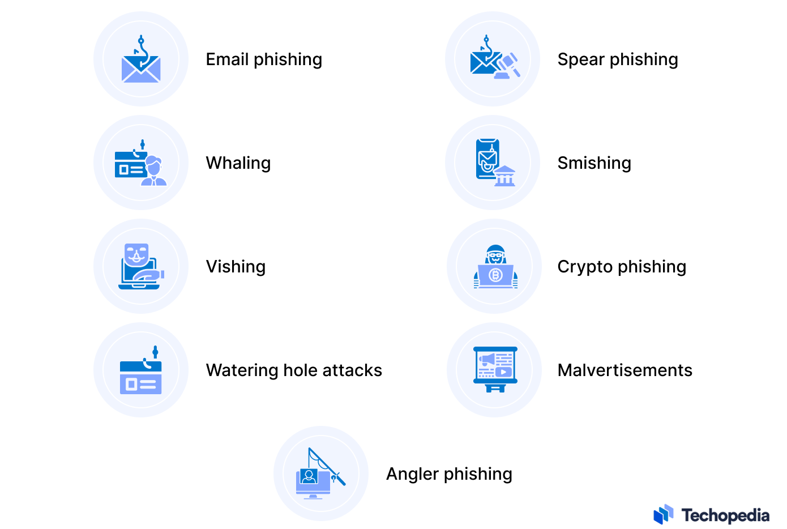
Types of Phishing Attacks?

Slide 10
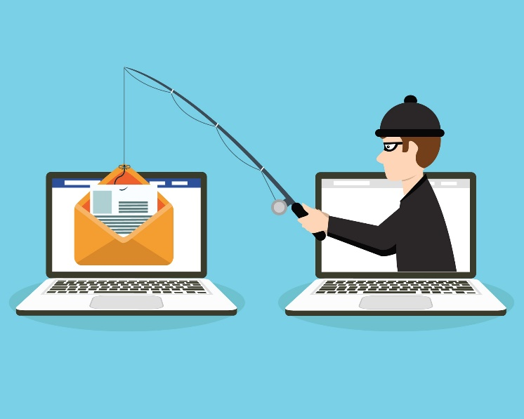
Email Phishing Attack
Email phishing is a deceptive technique used by cybercriminals to trick individuals into revealing sensitive information, such as login credentials, financial details, or personal information, by posing as a trustworthy entity.
Phishing emails often appear legitimate, creating a false sense of urgency or importance to prompt recipients to take immediate action.

Slide 11
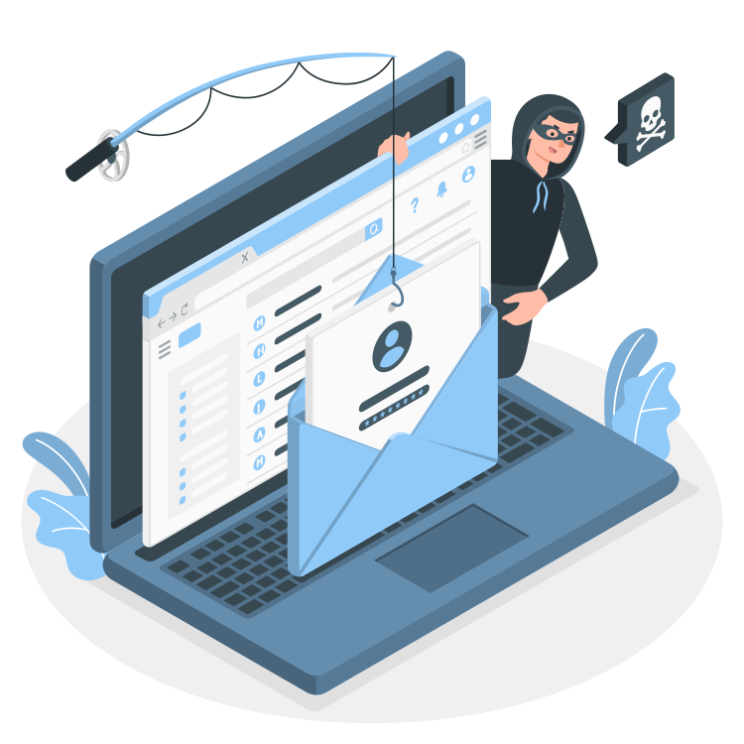
Common Characteristics of Phishing Emails
Sender Address Spoofing: Phishing emails often use a forged sender address to mimic a trusted entity, such as a bank, government agency, or reputable company.
Urgency and Fear Tactics: Phishing emails create a sense of urgency, urging recipients to act quickly to avoid negative consequences or loss of access to accounts.
Hyperlinks and Malicious Attachments: Phishing emails contain links that, when clicked, lead to fake websites designed to capture login credentials. They may also include malicious attachments that install malware on the recipient's device.
Generic Greetings and Misspellings: Phishing emails often use generic greetings (e.g., "Dear Customer") and may contain spelling or grammatical errors.

Slide 12
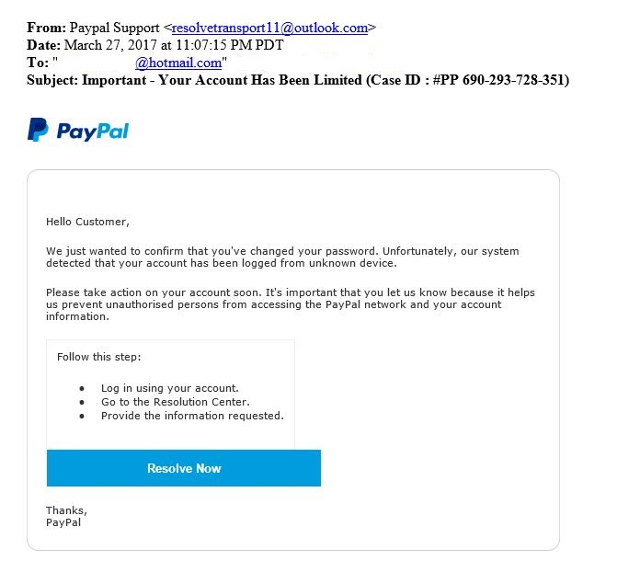
PayPal Phishing Email (2021)

Slide 13
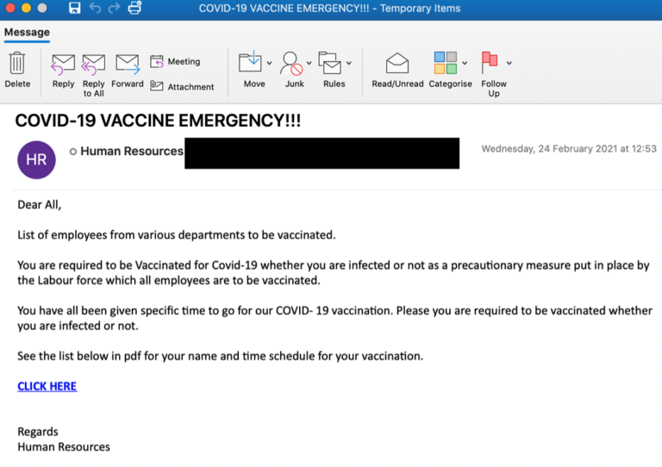

Slide 14
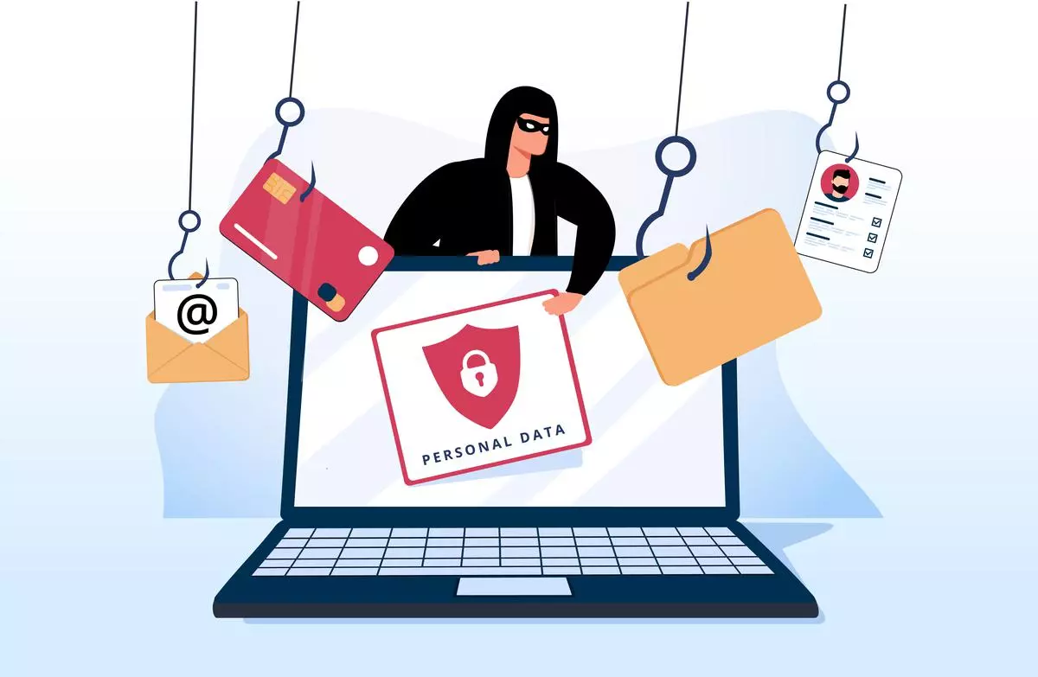
Prevention & Mitigation
Hover Over Links: Hover over links in emails to preview the actual URL before clicking.
Verify Email Addresses: Double-check sender email addresses for accuracy.
Use Multi-Factor Authentication (MFA): Enable MFA to add an extra layer of security to accounts.
Educate Users: Conduct regular cybersecurity awareness training to educate users about phishing techniques and red flags.
Report Suspected Phishing: Encourage users to report any suspected phishing emails to IT or security teams.

Slide 15
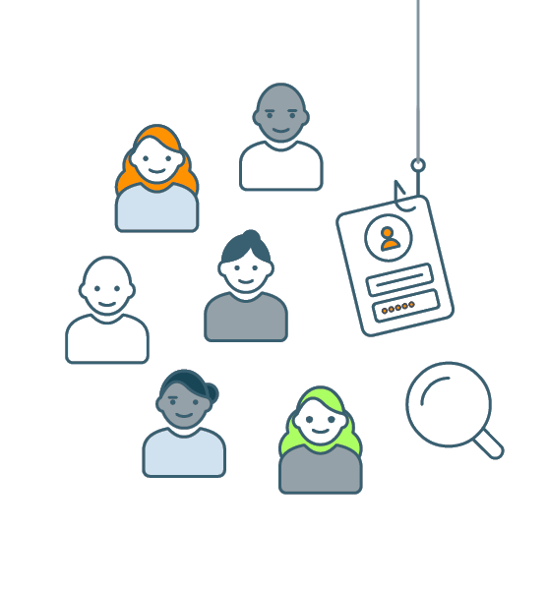
Spear Phishing
Spear phishing is a targeted form of phishing where cybercriminals customize their deceptive tactics to focus on a specific individual, organization, or group. Unlike generic phishing attempts that cast a wide net, spear phishing involves thorough research on the target to craft highly personalized and convincing messages.
The goal is to trick the recipient into divulging sensitive information or performing specific actions, often with financial or data theft motives.

Slide 16
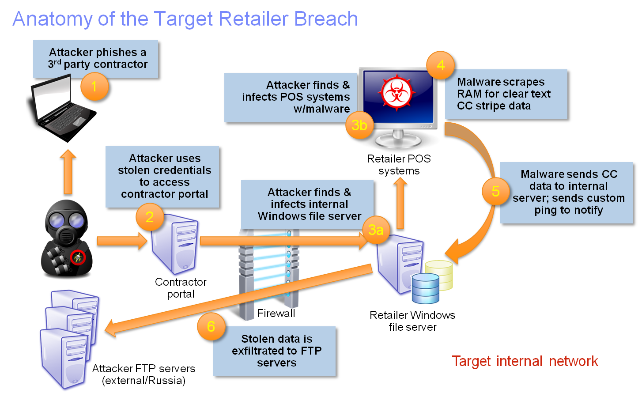
Real Time Example : The Target
Data Breach 2013
The Target data breach compromised the personal information of millions of customers.
The incident had severe financial consequences for Target, including legal settlements and a significant impact on its reputation.

Slide 17

Whaling Phishing Attack
Whaling, also known as CEO fraud or Business Email Compromise (BEC), is a sophisticated form of phishing attack that specifically targets high-profile individuals within an organization, such as executives, CEOs, or other top-level management. In a whaling attack, cybercriminals aim to deceive these individuals to gain unauthorized access, financial information, or sensitive company data.

Slide 18
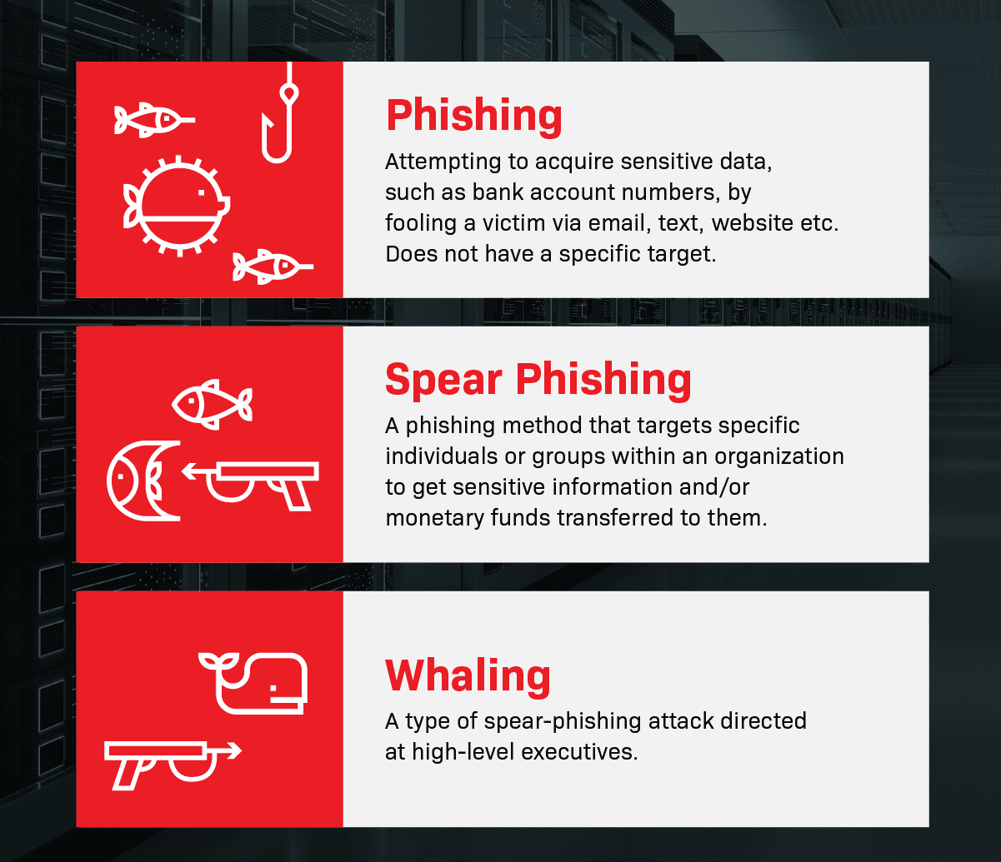

Slide 19
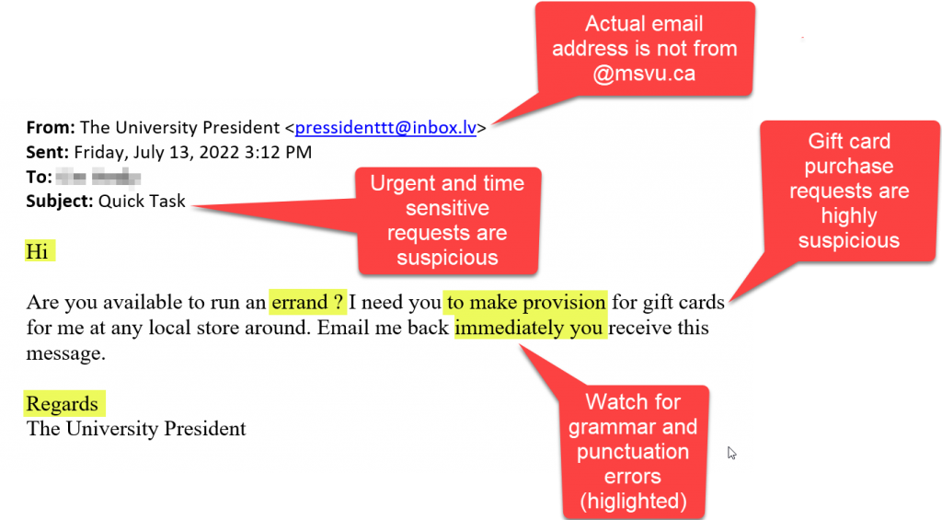
Example : Whaling Email

Slide 20
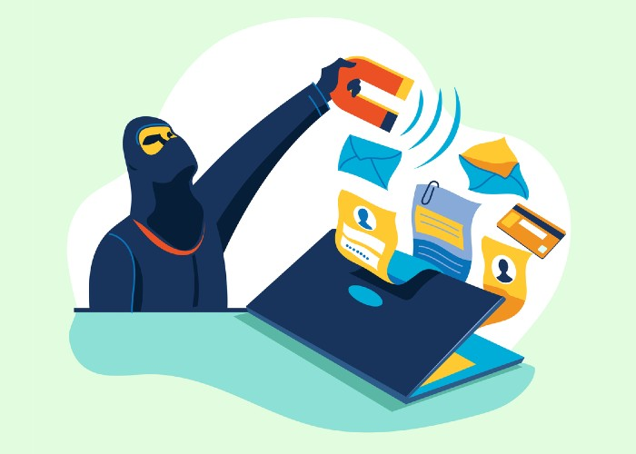
The Mattel Whaling Attack (2015)
In 2015, toy manufacturer Mattel fell victim to a whaling attack that resulted in a significant financial loss. Cybercriminals targeted the company's finance department with a phishing email impersonating Mattel's CEO.
Phishing Email: The attackers sent an email to a finance executive, posing as the CEO of Mattel.
Urgent Financial Request: The email requested an urgent payment of nearly $3 million to a Chinese vendor, citing the need to keep the transaction confidential due to ongoing negotiations.
Success of the Attack: The finance executive, believing the email to be legitimate and under pressure to act quickly, initiated the payment. It was later discovered that the funds were transferred to the attacker's account.

Slide 21
Consequences of Mattel Whaling Attack
Mattel suffered a financial loss of millions of dollars as a result of the whaling attack.
The incident highlighted the effectiveness of targeted attacks on high-profile individuals within an organization.
The Mattel whaling attack serves as a real-world example of the risks associated with targeted phishing attacks on high-level executives, illustrating the need for enhanced security awareness and measures to prevent such incidents.

Slide 22
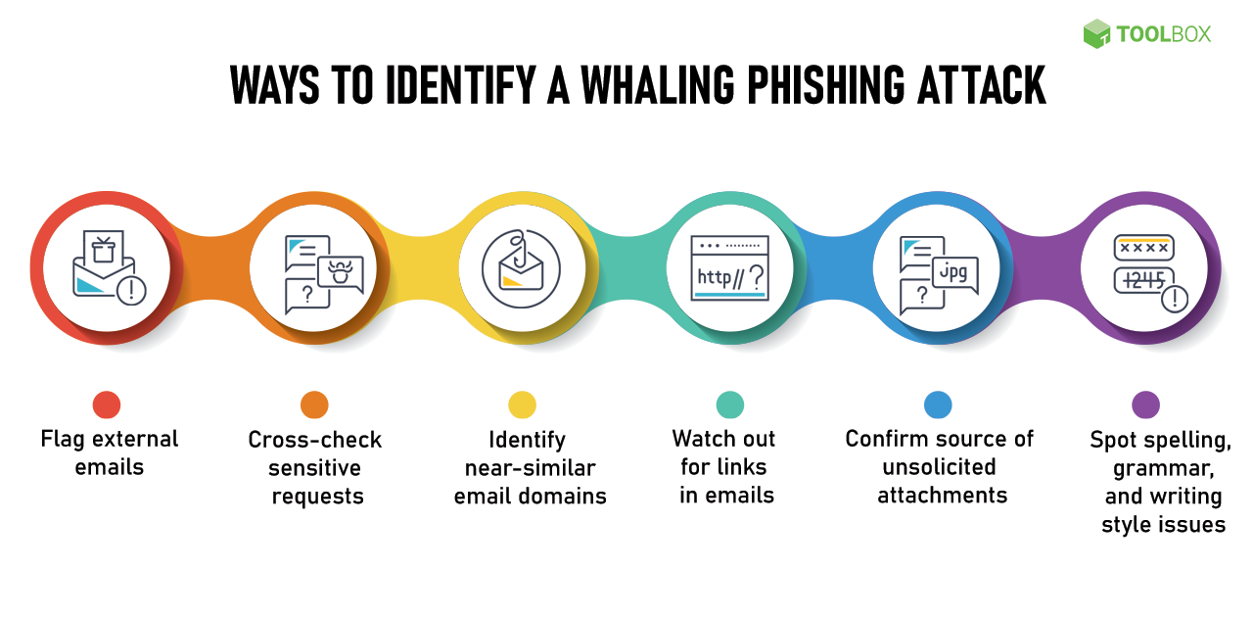

Slide 23
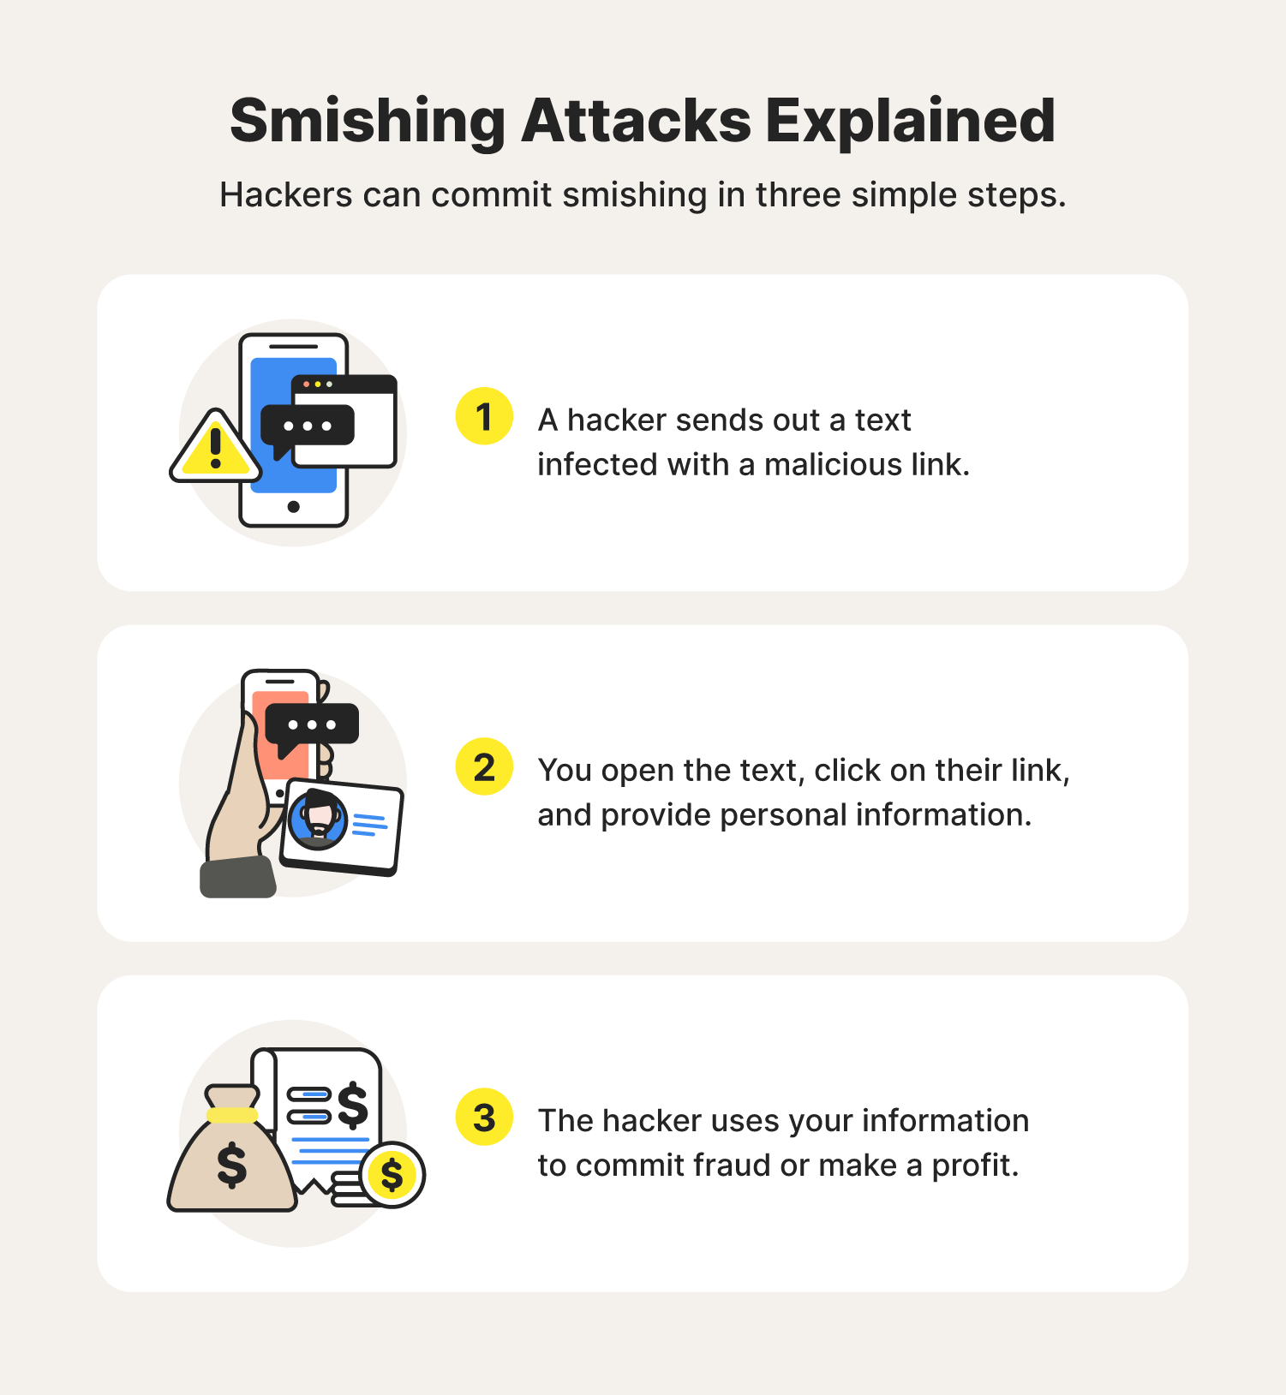
Smishing
Smishing is a cyber-attack that targets individuals through SMS (Short Message Service) or text messages. The term is a combination of “SMS” and “phishing.”
Smishing is done via text or instant messaging apps like WhatsApp and Telegram. The scammer provides their victim with a link, which, when clicked, will help them steal personal information or upload malware.

Slide 24
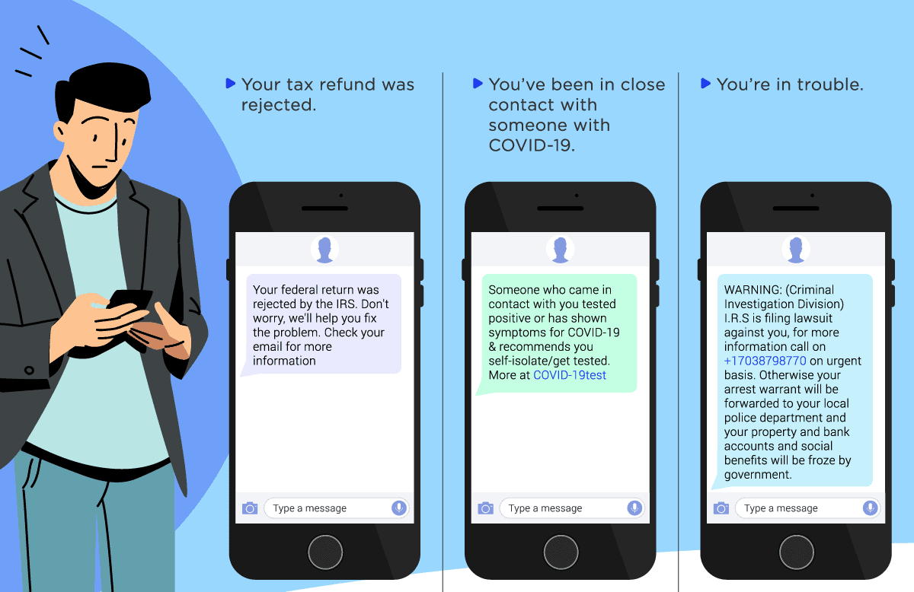

Slide 25
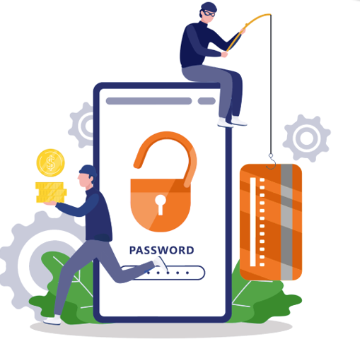
Vishing
Vishing is short for "voice phishing," which involves defrauding people over the phone, enticing them to divulge sensitive information. In this definition of vishing, the attacker attempts to grab the victim's data and use it for their own benefit—typically, to gain a financial advantage.
Vishers use fraudulent phone numbers, voice-altering software, text messages, and social engineering to trick users into divulging sensitive information.

Slide 26
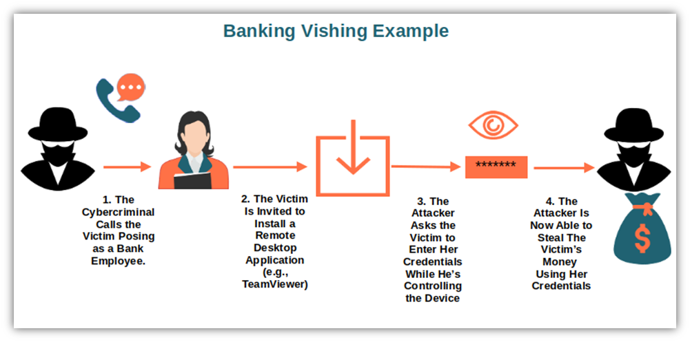

Slide 27
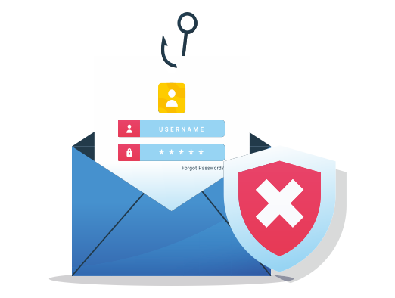
Business email compromise (BEC)
Business email compromise (BEC) is a type of cybercrime where the scammer uses email to trick someone into sending money or divulging confidential company info.
The culprit poses as a trusted figure, then asks for a fake bill to be paid or for sensitive data they can use in another scam.
A BEC attack takes advantage of a seemingly-legitimate email address to trick the recipient into taking a certain action. The most common goal of a BEC attack is to convince the target to send money to the attacker while believing that they are performing a legitimate, authorized business transaction.

Slide 28
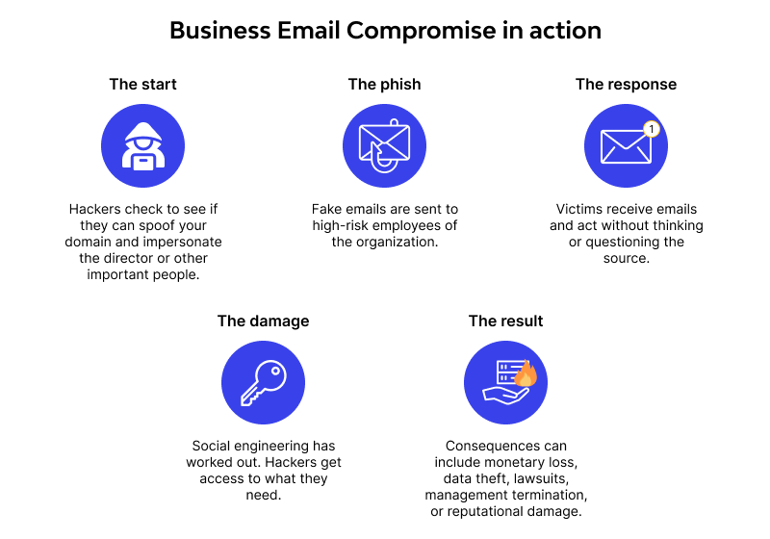
Anatomy of Business Email Compromise (BEC)

Slide 29
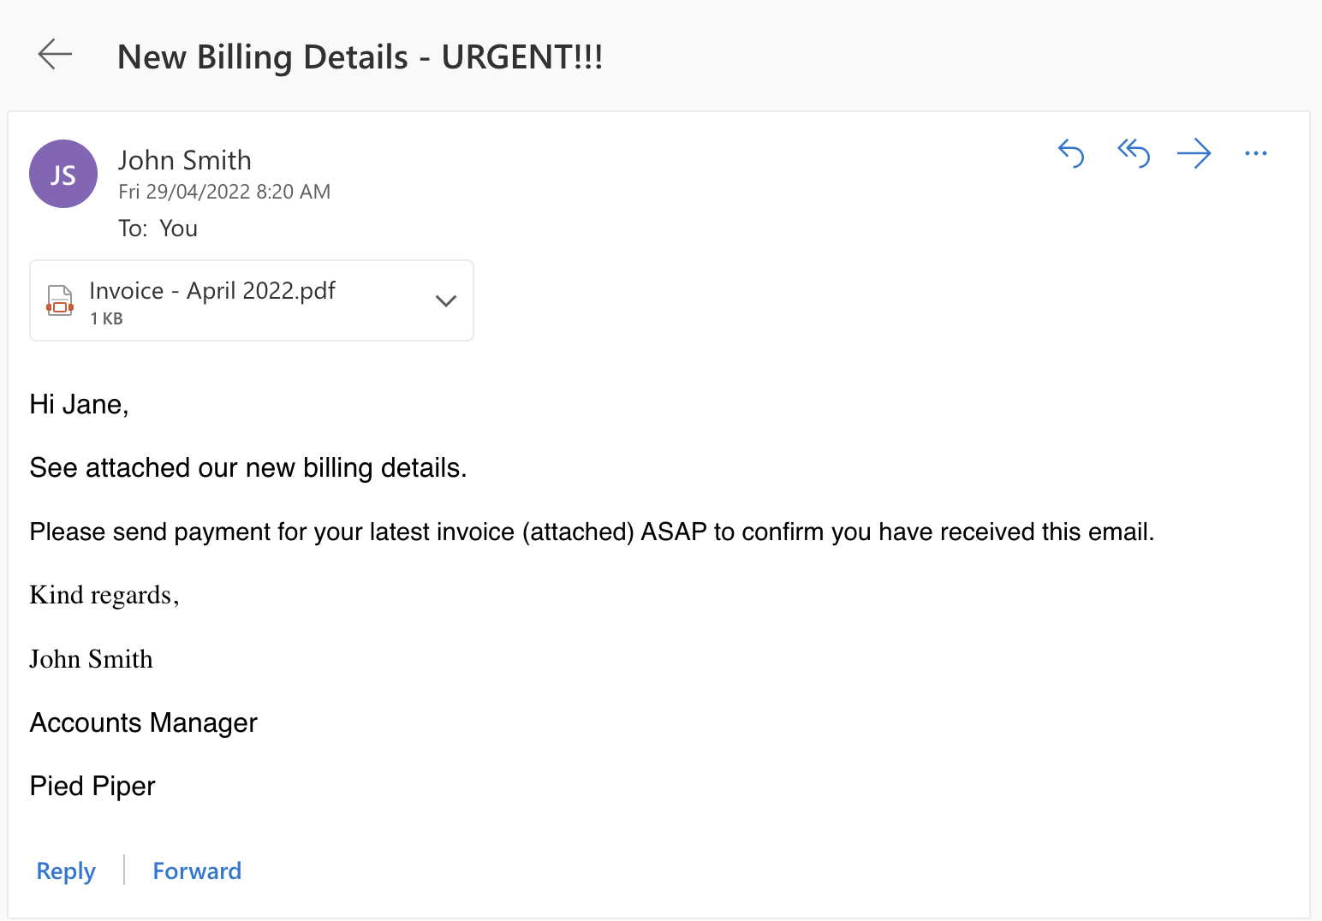

Slide 30
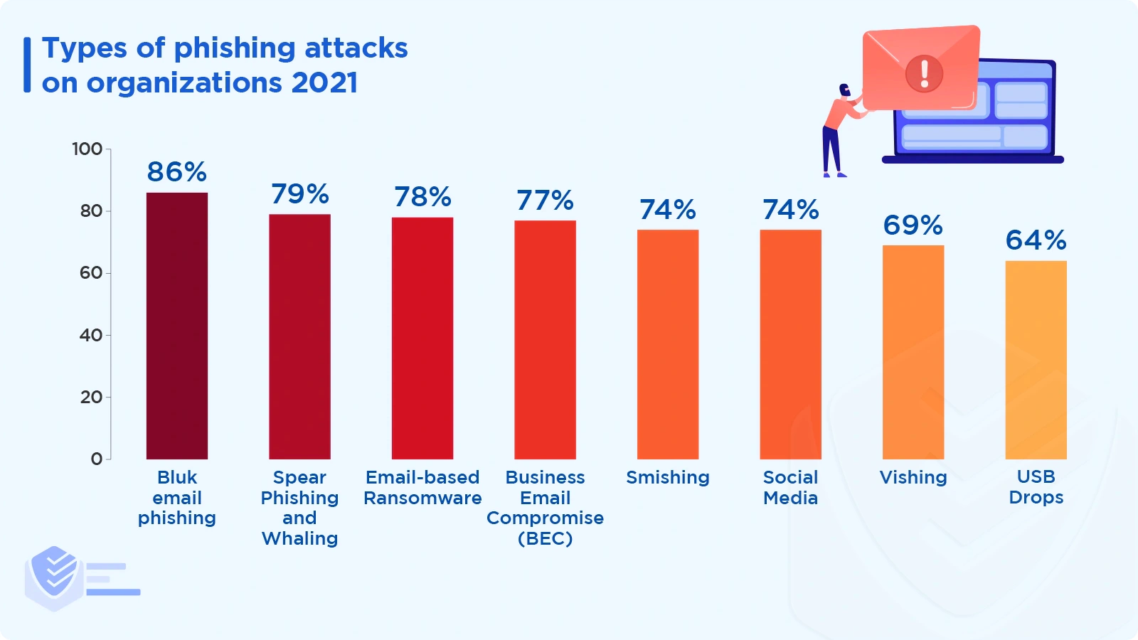
2021 - Present

Slide 31


